Slide 1


Transformer-Enhanced Multi-Scale Learning: A Hybrid Convolutional-Transformer Architecture for Robust Wound Segmentation
Organization:
Presented by:
Course
Bachelor of Technology (Computer Science)
Prathamesh Gadekar
112115115
Indian Institute Of Information Technology, Pune
Date:
Supervisor:
Semester
VIII
Dr. Sanjeev Sharma
(Associate Dean)
24th April 2025
Indian Institute of Information Technology, Pune. 27-02-2025

Slide 2
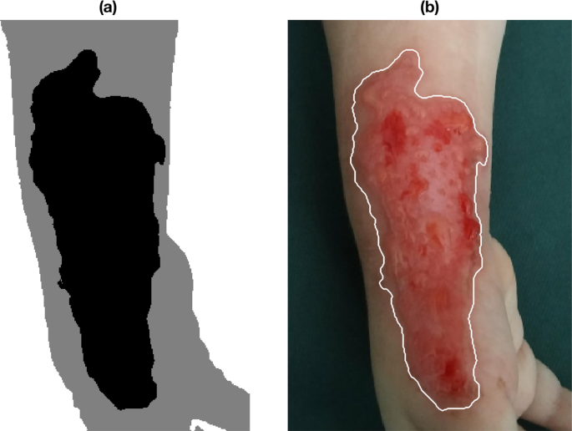
Introduction
Wound segmentation is the process of automatically identifying and outlining wounds in medical images.
Nearly 1 billion people suffer from acute and chronic wounds worldwide.
Acute wounds heal predictably, whereas chronic wounds (e.g., diabetic foot ulcers, leg ulcers, pressure ulcers) take much time to heal.
Wound segmentation is crucial for accurately measuring and tracking healing progress
[1]
Indian Institute of Information Technology, Pune. 27-02-2025

Slide 3
Drawbacks Of Traditional Approaches
Subjectivity & Inconsistency
Manual methods depend on the clinician’s expertise, leading to variability in measurements between different healthcare providers. The lack of a standardized approach increases the risk of inconsistent wound assessments over time.
Time-Consuming & Labor-Intensive
Measuring wound dimensions using rulers or tracing outlines requires significant time and effort.
Clinicians must document findings manually, adding to their workload and administrative burden.
Prone to Human Error
Estimating wound size by manual tracing can lead to imprecise measurements due to irregular wound shapes.
Indian Institute of Information Technology, Pune. 27-02-2025

Slide 4
Problem Statement
This project aims to develop an automated deep learning model that accurately segments wound areas from medical images. The model will be designed to handle the challenges of variable wound appearance and limited annotated data, ultimately supporting improved wound monitoring and management.
Indian Institute of Information Technology, Pune. 27-02-2025

Slide 5
Literature Review
Automatic Foot Ulcer Segmentation Using an Ensemble of Convolutional Neural Networks [2]
The authors propose an ensemble segmentation framework that combines two encoder–decoder CNNs—LinkNet with an EfficientNet‑B1 encoder and U‑Net with an EfficientNet‑B2 encoder—leveraging their complementary strengths. Both networks are first pre‑trained on the smaller Medetec wound dataset and then fine‑tuned on the target data. To maximize performance, the training employs five‑fold cross‑validation, and inference incorporates test‑time augmentations (rotations and flips) with simple averaging of the predicted probability maps.
Evaluated on Medetec (152 images), the Chronic Wound dataset (1010 images: 810 train/200 test), and the FUSeg Challenge dataset (1210 images: 200 private test), this ensemble attains on Chronic Wound a Dice of 92.07 %, IoU of 85.51 %, precision of 92.68 %, and recall of 91.80 %, and ranks first in MICCAI 2021 FUSeg with a Dice of 88.80 %, precision of 91.55 %, and recall of 86.22 %.
Indian Institute of Information Technology, Pune. 27-02-2025

Slide 6
Literature Review
2. WSNet: Towards An Effective Method for Wound Image Segmentation [3]
The research paper introduces WSNet, a deep learning framework for wound image segmentation, addressing the scarcity of diverse datasets and robust models in this domain. The model architecture combines global-local processing: a global sub-network (using U-Net, LinkNet, PSPNet, or FPN) processes the full image, while a local sub-network analyzes non-overlapping patches (48×48) to capture fine details. The framework employs wound-domain adaptive pretraining (WDAP) on 125K unlabeled images to enhance feature learning, followed by fine-tuning with data augmentation.
Experiments utilized WoundSeg, a novel dataset of 2,686 annotated images across eight wound types (diabetic, pressure, trauma, etc.), significantly larger and more diverse than existing datasets (AZH Woundcare, Medetec). Results showed a Dice score of 0.847 on WoundSeg, outperforming baseline models and achieving state-of-the-art performance on AZH (Dice: 0.927) and Medetec (Dice: 0.956). The segmentation also improved downstream tasks, reducing wound area/volume prediction errors.
Indian Institute of Information Technology, Pune. 27-02-2025

Slide 7
Literature Review
3. The Next Chapter in Wound Analysis: Introducing a Hybrid Model for
Improved Segmentation with the Deep Convolutional Neural Networks [4]
The research paper introduces M-Vgg19-Unet, a hybrid model combining VGG19 as the encoder and U-Net as the decoder, enhanced with skip connections and bilinear upsampling for wound segmentation. The model was trained and tested on an augmented dataset derived from the AZH Wound and Vascular Center’s foot ulcer dataset, expanding 1,109 original images to 16,860 training and 16,278 testing images via techniques like rotation, flipping, and zooming. Results demonstrated superior performance, achieving a Dice score of 92.02%, precision of 95.69%, and recall of 89.10%, outperforming SegNet, MobileNetV2, and standard U-Net.
However, the model’s drawbacks include high computational demands due to over 20 million trainable parameters, leading to longer training times.
Indian Institute of Information Technology, Pune. 27-02-2025

Slide 8
Literature Review
4. Fully automatic wound segmentation with deep convolutional neural networks[5]
The research paper presents a deep learning approach for fully automatic wound segmentation using a lightweight convolutional neural network based on MobileNetV2 combined with connected component labelling (CCL). Addressing the challenges of manual wound measurement in clinical settings, the authors developed a dataset of 1109 annotated foot ulcer images from 889 patients, validated by wound specialists. The proposed model leverages depth-wise separable convolutions to reduce computational complexity while maintaining accuracy, achieving a Dice coefficient of 90.47% on their dataset and 94.05% on the Medetec dataset. Post-processing with CCL effectively fills holes and removes noise in segmentation masks. Compared to models like VGG16, U-Net, and Mask-RCNN, the MobileNetV2 framework demonstrates superior efficiency with fewer parametersenabling potential deployment on mobile devices for real-time use.
Indian Institute of Information Technology, Pune. 27-02-2025

Slide 9
Literature Review
5. Wound Segmentation with U-Net Using a Dual Attention Mechanism and Transfer Learning [6]
The paper proposes a novel wound segmentation model that integrates a dual attention mechanism into a U-Net framework with a VGG16 backbone. By combining spatial attention gates and squeeze-and-excitation blocks, the model selectively enhances important features for improved segmentation accuracy.
The study used WTS, DFUC, STANDUP, and FuSeg datasets. The model is trained on DFUC but tested on other datasets to ensure model generalizability.
The dice score achieved were 90.2%, 92.9%, 89.6% and 88% on DFUC, STANDUP, FuSeg and WTS respectively. The IOU score achieved were 83.5%, 87.4%, 82.7% and 80.2% on DFUC, STANDUP, FuSeg and WTS respectively.
Indian Institute of Information Technology, Pune. 27-02-2025

Slide 10
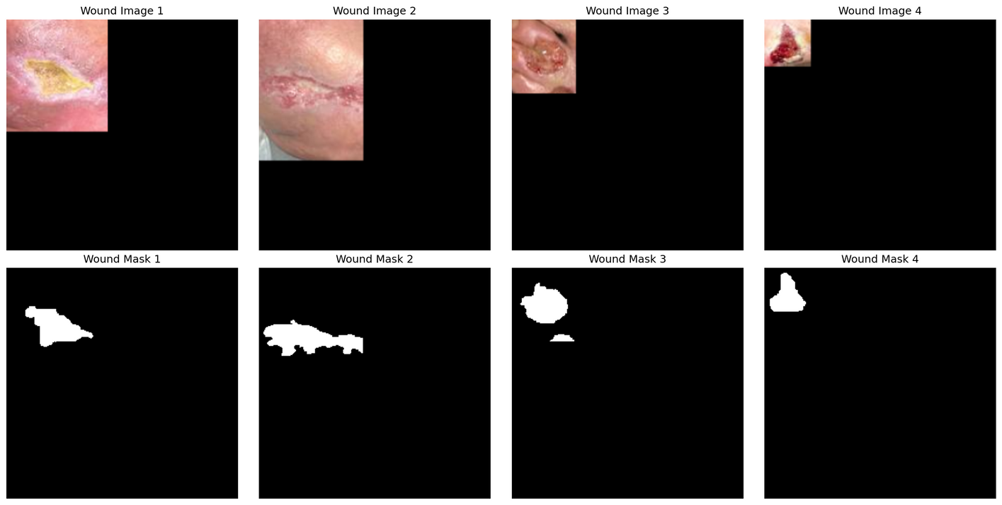
Datasets
AZH Dataset:
Contains 1109 high-resolution images of foot ulcers with corresponding masks. It was collected at AZH Wound and Vascular Center in Milwaukee, Wisconsin.
In this experiment, we split the dataset into 80% training data and 20% testing split.
Indian Institute of Information Technology, Pune. 27-02-2025

Slide 11
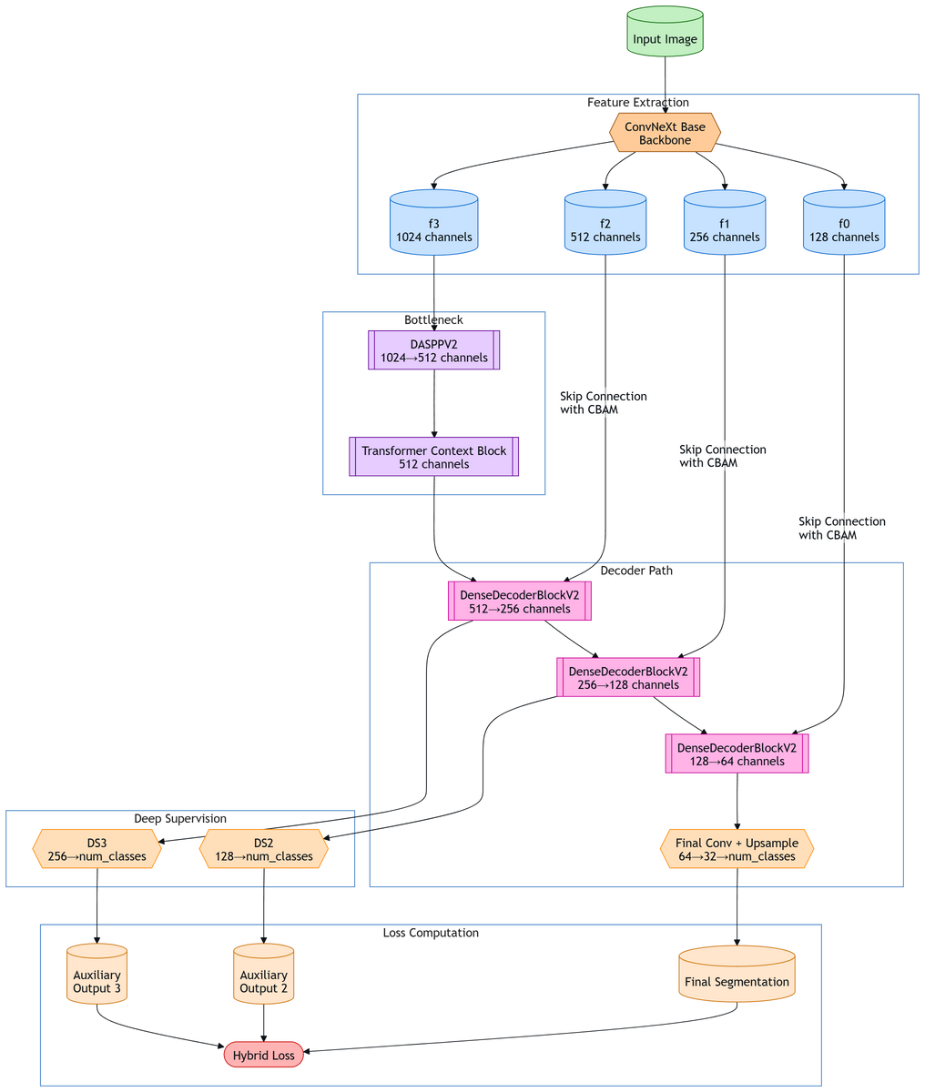
Proposed Model
Backbone:
ConvNeXt pre-trained backbone extracts multi-scale features (f0-f3) with resolutions [64, 32, 16, 8] for 256×256 input.
Dynamic Bottleneck:
DASPPV2: Processes deepest feature (f3) with adaptive dilation rates (1-24) and learnable branch weights.
Transformer Context Block: Adds global attention to capture long-range dependencies.
Indian Institute of Information Technology, Pune. 27-02-2025

Slide 12
Proposed Model
CBAM-Enhanced Decoder:
DenseDecoderBlockV2 progressively upsamples features while fusing skip connections refined by Channel-Spatial Attention (CBAM).
Skip connections from f0-f2 are adaptively recalibrated before fusion.
Deep Supervision:
Auxiliary losses at decoder stages (DS2, DS3) enhance gradient flow and combat vanishing gradients.
Indian Institute of Information Technology, Pune. 27-02-2025

Slide 13
Proposed Model
Hybrid Loss:
Dice Loss: Measure the similarity between predicted and ground truth segmentation masks.
Focal Loss: Focuses on hard examples using BCE.
Boundary Loss: Penalizes edge discrepancies using L1 loss.
IoU Loss: Directly optimizes intersection-over-union metric.
Indian Institute of Information Technology, Pune. 27-02-2025

Slide 14
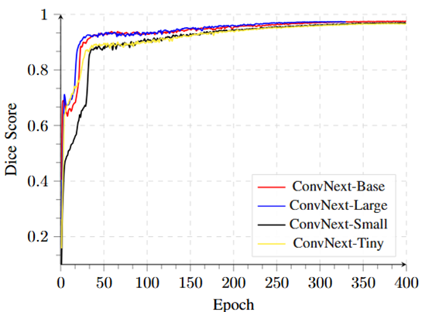
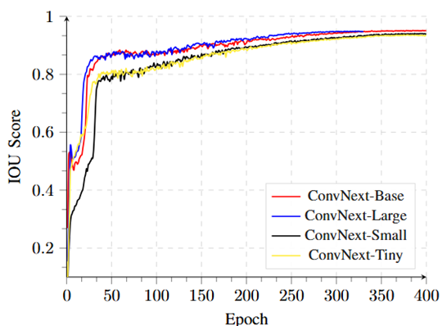
Results
Indian Institute of Information Technology, Pune. 27-02-2025

Slide 15
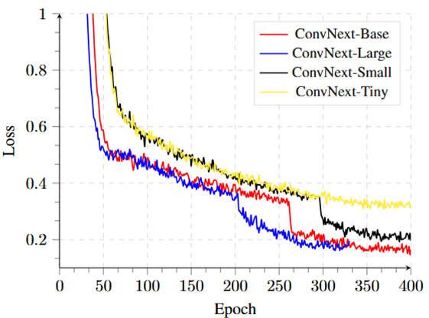
Results
Indian Institute of Information Technology, Pune. 27-02-2025

Slide 16
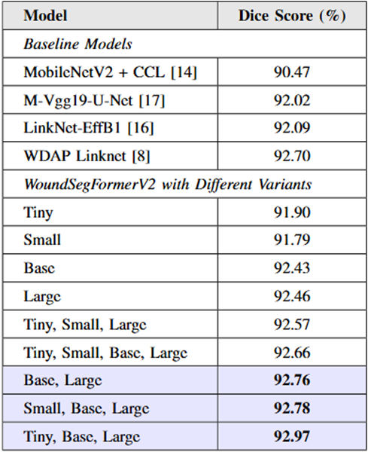
Results
Indian Institute of Information Technology, Pune. 27-02-2025

Slide 17
Results
1. Cirillo, Marco & Mirdell, Robin & Sjöberg, Folke & Pham, Tuan. (2019). Tensor Decomposition for Colour Image Segmentation of Burn Wounds. Scientific Reports. 9. 3291. 10.1038/s41598-019-39782-2.
2. A. Mahbod, G. Schaefer, R. Ecker and I. Ellinger, "Automatic Foot Ulcer Segmentation Using an Ensemble of Convolutional Neural Networks," in 2022 26th International Conference on Pattern Recognition (ICPR), Montreal, QC, Canada, 2022, pp. 4358-4364, doi: 10.1109/ICPR56361.2022.9956253.
3. S. R. Oota, V. Rowtula, S. Mohammed, M. Liu and M. Gupta, "WSNet: Towards An Effective Method for Wound Image Segmentation," 2023 IEEE/CVF Winter Conference on Applications of Computer Vision (WACV), Waikoloa, HI, USA, 2023, pp. 3233-3242, doi: 10.1109/WACV56688.2023.00325.
4. Morol, Md. Kishor & Fahad, Nafiz & Juabir, Abdullah. (2024). The Next Chapter in Wound Analysis: Introducing a Hybrid Model for Improved Segmentation With the help of Deep Convolutional Neural Network. Journal of Advanced Research in Applied Sciences and Engineering Technology.
Indian Institute of Information Technology, Pune. 27-02-2025

Slide 18
Results
5. Wang, C., Anisuzzaman, D.M., Williamson, V. et al. Fully automatic wound segmentation with deep convolutional neural networks. Sci Rep 10, 21897 (2020). https://doi.org/10.1038/s41598-020-78799-w
6. Niri, R., Zahia, S., Stefanelli, A. et al. Wound Segmentation with U-Net Using a Dual Attention Mechanism and Transfer Learning. J Digit Imaging. Inform. med. (2025). https://doi.org/10.1007/s10278-025-01386-w
Indian Institute of Information Technology, Pune. 27-02-2025

Slide 19










THANK YOU

